Slide 1
Diversity, Equity & Inclusion Talent Marketing Playbook
Morgan Grey

Slide 2
Diversity, Equity & Inclusion at Roche - Why DEI & putting guidelines into practice
Inclusive Talent Attraction - Inclusive language in brand communications, design and imagery
Appendix - Channels and other resources
Table of contents

Slide 3
DE&I

Slide 4
About this Playbook
We are all catalysts for DEI - this playbook aims to guide you in integrating DEI elements into talent attraction content
Using inclusive language and imagery in job postings and recruitment materials can attract a broader pool of candidates, promoting a diverse applicant base.
Showcasing diversity in recruitment campaigns positions the company as an inclusive and attractive employer, enhancing the overall brand perception.
Integrating diverse imagery and inclusive language into training programs can make learning experiences and communication more relatable and effective, fostering a sense of belonging that improves employee retention.
Through our Talent Marketing efforts, we aim to contribute towards increasing the number of women in executive positions by +1p%
and the number of underrepresented nationalities in executive positions by +1p%.
Notes:
We created this playbook to help the Marketing & Programs team gain a better understanding of how to be more inclusive in their marketing efforts. We saw a gap in our Talent Marketing campaigns and social media posts and wanted to create a simple way for our team and anyone outside our team the ability to easily implement simple practices into their talent attraction strategies.
This playbook helps you better understand how to implement:
inclusive language and diverse imagery within our talent attraction efforts.
Also how to promote inclusive design on our social media platforms, and how to better implement inclusive marketing strategies.

Slide 5

Why DE&I
Doing now what patients need next by embracing DE&I to improve patient outcomes
We are investing in DE&I,
because it works - for our people and for our patients
Bringing people together with different backgrounds, skills, and experiences AND creating an inclusive environment where perspectives are shared, challenged and appreciated drives innovation and performance.
Equity means giving people and groups fair access to opportunities, with consideration for their unique differences, to create equal outcomes.
By representing the diverse patients we serve, we better understand their needs and improve health outcomes.
Based on research, creating an inclusive culture and environment has a two fold effect:
Positively influences employee engagement, wellbeing, motivation and resilience
Drives business results through increased innovation and improved performance
50% lower turnover risk¹
56% increase in job satisfaction¹
75% reduction in sick leave¹
17% increase in team performance²
20% increase in decision-making quality²
29% increase in team collaboration²
30% increase in spotting risk²
2x more likely to meet or exceed financial targets²
Why DE&I?
Inclusion is the key
Proof points of inclusion
Notes:
We thought it would be important to share this information, for you all to understand how important DE&I is for the business.
Plain and simple, DE&I is good for business.
According to research from Monster, 86% of job seekers believe that a company’s approach to diversity, equity, and inclusion (DEI) is an important factor when considering an employer.
An inclusive environment not only ensures equitable access to resources and opportunities for all, it empowers individuals and groups to feel psychologically safe, respected, engaged, motivated, and valued.
When people at all levels and in all departments recognize and commit to the importance of inclusive practices, place people beyond their descriptors, and embrace a growth mindset about updating their vocabularies, employees will feel a greater sense of belonging–and are 50% less likely to leave.
Being culturally mindful can be understood as leading out on policy, action, and communication that relates respectfully with and benefits people of all cultures.
https://www.bcg.com/publications/2017/people-organization-leadership-talent-innovation-through-diversity-mix-that-matters
https://www.mckinsey.com/featured-insights/diversity-and-inclusion/diversity-matters-even-more-the-case-for-holistic-impact
https://www.forbes.com/sites/eriklarson/2017/09/21/new-research-diversity-inclusion-better-decision-making-at-work/?sh=4f41c5674cbf

Slide 6
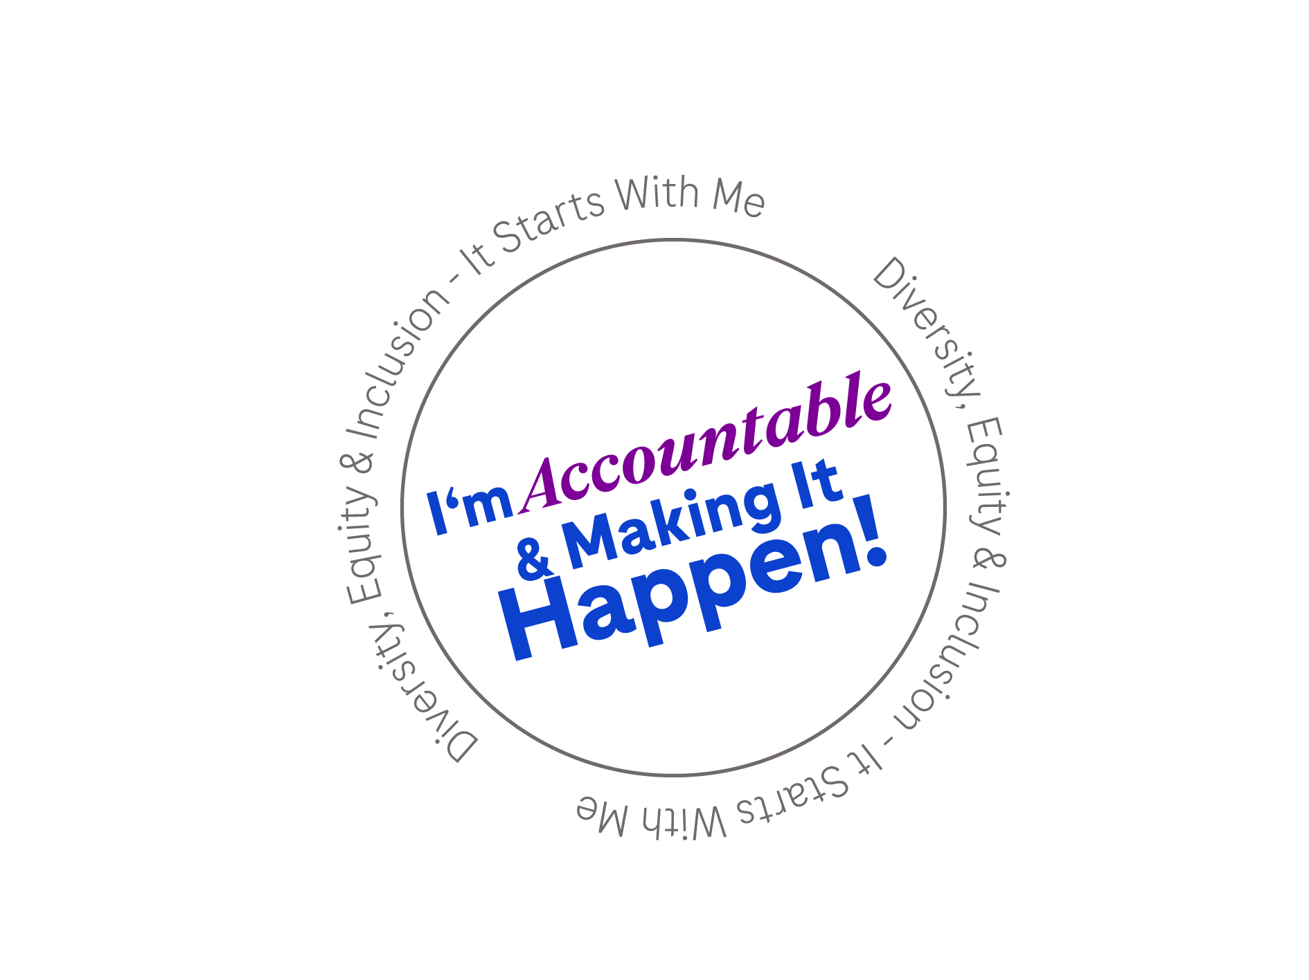
Global DE&I strategy
2024 onward: an evolution for greater focus and impact
Together we embrace the unique power of each person
to transform the lives of patients & society
Patients
addressing the unmet needs of diverse patients & communities
People
building a workforce that reflects the societies we serve
Culture
ensuring everyone can be themselves, do their best work and thrive
Society
advancing positive change in society
From
Patients
addressing the unmet needs of diverse patients & communities
Culture & People
building a workforce that reflects the societies we serve ensuring everyone can be themselves, do their best work and thrive
Society
advancing positive change in society
To
Notes:
What we are trying to achieve with playbook:
We hope to resonate with various cultures, backgrounds, abilities, genders, sexual orientations, ages, and identities, by creating and distributing inclusive marketing messages.
Authentically portray diverse individuals in advertisements, content, and branding in a way that accurately represents our global society while promoting inclusivity.
Enhancing our brand reputation and loyalty by representing our candidates in an authentic way
Upskilling our Talent Marketing team to create inclusive marketing campaigns aimed at being accessible to everyone.

Slide 7


How it ladders up to our 10 year ambition for DEI
Together towards our collective purpose
Roche’s 10 year ambition
How we contribute to this
We want to achieve representation of global society, employing people from a wide range of backgrounds and cultures.
Our long-term commitment to Diversity, Equity & Inclusion will enable us to attract the best people, support all people to do their work in a great environment, and achieve our individual as well as collective potential.
Embedding DEI into our Talent Marketing strategy to attract diverse talents who possess valuable expertise and fresh perspectives.
Amplifying our inclusive work culture to enhance our employer brand and promote Roche as an employer of choice.
Notes:
How we plan to ladder up these tactics to achieve our 10-year ambition:
Activating Talent Marketing strategy to target our global society that represents a wide range of backgrounds and cultures.
By casting a net that expands beyond cultural differences we can identify candidates who may possess valuable expertise and fresh perspectives.
By amplifying our inclusive work culture we can attract top talent.
Embracing DE&I in our Talent Marketing will make our employees feel more valued and motivated to contribute their best work.

Slide 8
DEI Talent Marketing

Slide 9
Elements of inclusive talent marketing
Inclusive talent marketing hinges on the following key elements:
Inclusive language & Imagery
Using inclusive language is an important aspect of promoting diversity, equity, and inclusion in communication and ensuring we have an environment where everyone feels like they belong and are able to bring their best selves to work and thrive.
Inclusive content design
Inclusive content design for candidate experience ensures that our content on key candidate touchpoints are accessible and digestible by everyone, regardless of ability or background. This enhances the candidate experience - and in turn our employer reputation
Inclusive channels & tools
Using inclusive channels and tools in recruitment marketing expands our reach, attracting a diverse range of talented individuals. It ensures our efforts resonate with all candidates, fostering equity and enriching our talent pool.
Notes:
Here are the main elements of inclusive marketing:
Diversity and representation: Portray a diverse range of people from different ethnicities, races, ages, genders, body types, abilities, sexual orientations, and socio-economic status.
Authenticity: Focus on understanding, respecting, and accurately reflecting diverse communities in marketing campaigns.
Accessibility: Make products, services, and information accessible to individuals with disabilities by designing websites, apps, and physical spaces that accommodate different groups.
Cultural sensitivity: Be culturally sensitive by avoiding stereotypes and ensuring respectful representation in all aspects of marketing efforts.
Consumer engagement: Create a sense of belonging and connection by celebrating differences.
Business impact: Bolster your company's image by reaching a wider audience, enhancing customer loyalty, and improving reputation through inclusive marketing.

Slide 10
Inclusive Language & Imagery

Slide 11
Inclusive language
How can you write inclusively?
Avoid using language that may discriminate or stereotype individuals based on their age.
Treat people as individuals, recognizing their skills, experiences, and contributions rather than making assumptions based on age.
Use gender-neutral terms when referring to relationships or marital status. Instead of assuming someone's marital status, use terms such as "partner" or "spouse" to be inclusive of all types of relationships.
Understand that individuals may have multiple aspects of their identity that intersect, such as race, gender, and ability. Be mindful of this intersectionality and use language that acknowledges and respects these diverse identities.
Continuously educate yourself on inclusive language and be open to feedback from others. Language evolves, and it's important to stay informed and make adjustments when necessary.
By using inclusive language, you create a more welcoming and respectful environment where everyone feels valued and included. Remember, it's an ongoing learning process, so be open to feedback and strive to continuously improve your language choices.
Notes:
Look at your language
Use inclusive language where possible and ensure that your job ads are read by a diverse range of your team members before you put it live.
Understand phrases that different communities use to describe themselves to ensure your ads are searchable and inclusive to a wider variety of people.
Understand varying priorities and attitudes to work
To create a genuinely inclusive job ad or recruitment marketing campaign, you need to understand what is important to a wide range of people and cover all priorities.
Avoid stereotyping
To avoid being accused of stereotyping, it would help to tell real stories of people within your organisation.
This shows you are an inclusive and supportive employer but also gives real background to your candidates.
Share stories and employee-generated content as part of your recruitment marketing, and you will naturally be promoting your inclusive culture.

Slide 12

Inclusive language
Tip: Utilize inclusivity tools and resources: Leverage tools like inclusive language checkers(Textio)
Here are some tips on how to use inclusive language:
Respect religious and cultural diversity: Be mindful of religious and cultural sensitivities when using language. Avoid assumptions or generalizations based on someone's religious or cultural background. Seek to understand and respect diverse beliefs and practices.
Avoid negative phrases referring to disability: Don’t use phrases like “is afflicted by” or “suffers from” when discussing disabilities. Seek to use language that puts the person first and doesn’t define them by their characteristics.
Consider gender identity: When speaking about an individual, never assume a person’s gender identity based on their name or their appearance — if you don’t know, use gender-inclusive pronouns.
Make Your Content Easy to Navigate: Ensure that the content on your site is easy to navigate. Use descriptive headings. Different headings will help users to understand the hierarchy of your content and will also make it easier for people who use screen readers to navigate through your website.
Avoid gendered language: Instead of using gender-specific terms like "he" or "she", use gender-neutral alternatives such as "they" or rephrase the sentence to be gender-inclusive. For example, instead of saying, "Each employee should bring his own laptop", you can say, "Each employee should bring their own laptop." “Hi guys” is a gendered language, consider: "Hi everyone!", "Hey all!", "Hello team!" etc.
Use inclusive pronouns: Be respectful and use individuals' preferred gender pronouns. If you are unsure, use gender-neutral pronouns such as "they" until you have the opportunity to clarify. It is important to create an environment where people feel comfortable expressing their gender identity.
Be mindful of cultural references: Avoid using cultural references or idioms that may exclude or alienate individuals from different backgrounds. Opt for more inclusive and universally understandable language.
Consider different abilities: Use language that is inclusive of individuals with disabilities. Avoid derogatory terms or language that perpetuates stereotypes. Instead, focus on the person first and their abilities rather than their disability.
Notes:
For this slide, read the bolded text.
Highlight Textio:
Textio is a tool for use in creating inclusive job descriptions, ads, and other communications that will help us attract and engage a diverse set of candidates who share our values of diversity, equity, and inclusion.
This intuitive tool will allow hiring managers and committees to paste, write, and/or store job descriptions in a designated database.
Utilizing data from millions of hiring documents nationally and worldwide, Textio provides immediate feedback and analytics:
Highlighting language that may carry bias;
Identifying the groups that may be negatively impacted by that language;
Providing suggestions for more inclusive language that will appeal to a more diverse audience.
Additionally, Textio provides an “inclusivity score” so hiring managers and divisions can track their progress from position to position and division-wide.
Writers can see whether the job post they’re drafting might discourage women from applying, for example, or whether their word choice appeals only to millennials. Companies have adopted Textio as one component of broader efforts to attract a more diverse group of applicants, and to hire more fairly and effectively.

Slide 13
Diverse & inclusive imagery
Advertising can help to reinforce biases, prejudices, and stereotypes
Our audience wants to see themselves in your content, and more importantly, they want to know that you see and understand them, too.
Make a demographic checklist:
  Gender: Gender can be thought of in two ways: gender identity, or how you see yourself, and gender expression, or how you express your gender identity outwardly.
  Abilities: The emphasis on the individual, rather than their physical or cognitive impairment, reflects the reality that millions of consumers live active, dynamic lives despite visible or invisible disabilities
  Age: Including older people older than 50 in your campaigns helps your marketing reflect reality and gives you a better chance of tapping into this growing market.
  Body type: Displaying realistic and diverse bodies is a daring and inclusive step that can help your campaign stand out and even improve brand perception.
Keep your bias in check
  To avoid preserving existing stereotypes, choose visual content that purposefully puts different types of people in the spotlight, particularly in roles or circumstances that they might not typically be associated with.
Notes:
There is a famous quote from Sims- Bishop “When people 'cannot find themselves reflected in the books they read', or in the images they see 'they learn a powerful lesson about how they are devalued in a society of which they are a part.” (1990)
Diverse and inclusive imagery is crucial as it communicates that an organization values representation, welcomes people from all backgrounds, and is committed to creating a culture of inclusivity.
Creating content that resonates across cultures is important for genuine connection with the target audience.
Diverse marketing content should go beyond mere visibility to craft thoughtful and respectful messages, visuals, and narratives that reflect a spectrum of cultures and identities.
This helps potential candidates feel valued and included.
Using inclusive imagery can signal to potential employees that a company is open to a diverse workforce, attracting a wider pool of qualified candidates.
Additionally, showcasing people from various backgrounds in typical roles can help dismantle harmful stereotypes and promote a more accurate representation of society.

Slide 14
Diverse & inclusive imagery
Food for thought when selecting imagery and illustrations
Avoid bias by selecting visual content that highlights diverse individuals in non-traditional roles and contexts.
Ensure the use of authentic images featuring our actual employees rather than edited stock photos.
Our Roche and Genentech libraries provide brand-compliant examples.
Look into your local demographics – this can give you an indication of what the percentage distribution of characteristics might look like so that local employees feel sufficiently represented.
Notes:
Important aspects of inclusive imagery:
Representation of various demographics:Including people of different races, ethnicities, genders, ages, abilities, and sexual orientations.
Authentic portrayal: Avoiding stereotypes and depicting people in realistic situations that accurately reflect their identities.
Contextual relevance:Ensuring the imagery aligns with the message being communicated and is not tokenistic.
*Note: there may be some limitations of the types of photos that we have in the media library.*

Slide 15
Inclusive Design

Slide 16
Inclusive design for Social Media
Provide an image description or alternative text
  Image descriptions describe essential elements in a photo while alternative text (alt. text) is an invisible description narrated through a screen reader. Both allow for those with visual impairments to better interpret a photo.
  Facebook, Twitter, Instagram and LinkedIn all offer ways to add alt-image descriptions. Facebook automatically assigns alt text to uploaded images, but it’s best to double-check the generated text and adjust as needed.
Include open or closed captioning for video content.
  Captions are a prime example of how inclusive design benefits everyone.
  Captions not only help people with hearing impairments, but they also help new language learners and viewers watching videos with the sound off.
Write multi-word hashtags
  Don’t write your hashtags #LIKETHIS or #likethis.
  Capitalize the first letter of every word to make multi-word hashtags easier for screen readers to differentiate between words.
Create accessible visuals
  Users with vision impairments rely heavily on tools like screen readers to navigate the internet and understand visual information.
Memes and emojis
  If a brand uses an emoji to convey something different than its literal meaning, this context may be lost when interpreted through assistive tools like screen readers.
  Even if the meme includes alt text, it may be hard to describe the punchline through text alone.
Notes:
Inclusive design in social media refers to designing social media platforms, features, and content to ensure that all users, regardless of their background or abilities, can participate fully and engage on social media.
Inclusive design considers different users’ diverse needs and experiences when creating content.
This can include designing for users with disabilities, different languages or cultural backgrounds, or other unique needs.
Why accessibility matters:
At least one billion people — 15% of the world’s population — experience some form of disability.
The World Health Organization estimates 33% of the global population has a hearing or sight impairment.
Since users primarily consume social content through audio and visuals, accessibility in social media is crucial.
Social Media can be a source of frustration for users with disabilities or unique needs.
Inaccessible social media content can prevent these users from engaging with the world of social.
Accessible content can reach more people and be more engaging.

Slide 17
Channels & Tools

Slide 18

Canva
Tips and tricks on using Canva to create accessible, inclusive content
Translate your designs
Automatically translate pages of your designs via the Translations add-on in Canva to make them accessible to more audiences. Canva currently support over 100+ languages.
Use diverse imagery and illustration
Utilize the wide range of diverse imagery and illustration made available from the Roche & GNE library into your Canva design
Input alternate text on images or graphics
Add descriptive alternative text (alt text) for every image or graphic you include. Alt text should briefly describe the content and purpose of the image. In Canva, you can add alt text by selecting the image, right-clicking and choosing “Alternative text.”
PDF accessibility features
When saving or extracting your file as a PDF, it can now include heading tags and reading order, enhancing the reading experience for screen reader users. This feature is available for all PDF-published documents.
Notes:
For those of you that have access to Canva, the platform offers several features to help you create accessible content, including social media posts, presentations and infographics.

Slide 19
Alternative job boards for diversity hiring
Diverse job boards and professional associations may allow companies to tap into a diverse pool of candidates.
DE&I recruiting requires a multi-dimensional approach, with diverse job boards being just one method. Use the decision framework and guiding questions (see Slide 10) to decide on job board postings. *Always use a tracking source code for diverse job boards to assess their effectiveness*
We also encourage hiring teams and employees to join local diverse professional associations. Expanding networks through these associations enhances our reach and employer brand exposure.
Link to US diverse professional associations.
Region | Demographic | Website
APAC | PWD | https://www.avtarinc.com/
Global | ALL Groups | https://www.equest.com/
US | ALL Groups | https://www.prodivnet.com/
US | Veterans | https://www.military2career.com/
US | PWD | https://www.abilitycareers.com/
US | Asian professional | https://www.acareers.net/
US | Women professionals | https://www.womenscareerchannel.com/
US | Black professionals | https://www.blackcareernetwork.com/
US | LGBTQIA professionals | https://www.lgbtqcareernetwork.com/
US | Latinx professionals | https://www.ihispano.com/
Global | ALL Groups | https://www.jopwell.com/
US | Latinx professionals | https://hlpa.com/
EMEA | ALL Groups | https://www.diversifying.io/
EMEA | ALL Groups | https://www.emearecruitment.com/
EMEA | Black professionals | https://ada-netzwerk.com/
*This is not an exhaustive list, further research should be done.*
Notes:
This diversity job boards list is just a reference resource/guide for TM to consider for campaign needs as additional channel.
We ask that you all are proactive in your research to find other job boards in your region.

Slide 20
Resources
Further guidance and reading
Language Bias
DE&I Glossary
DE&I Resources
Embedding an inclusion lens
Social Media Accessibility

